Slide 1
PIR Sensor
Pyroelectric ("Passive") InfraRed Sensor

Slide 2
AGENDA
Introduction​
How PIRs Work?
​Connecting to a PIR
Testing a PIR
​Using a PIR w/Arduino​
Reference Link

Slide 3
Introduction
PIR sensors allow you to sense motion, almost always used to detect whether a human has moved in or out of the sensors range.
They are small, inexpensive, low-power, easy to use and don't wear out.
For that reason they are commonly found in appliances and gadgets used in homes or businesses.
They are often referred to as PIR, "Passive Infrared", "Pyroelectric", or "IR motion" sensors

Slide 4
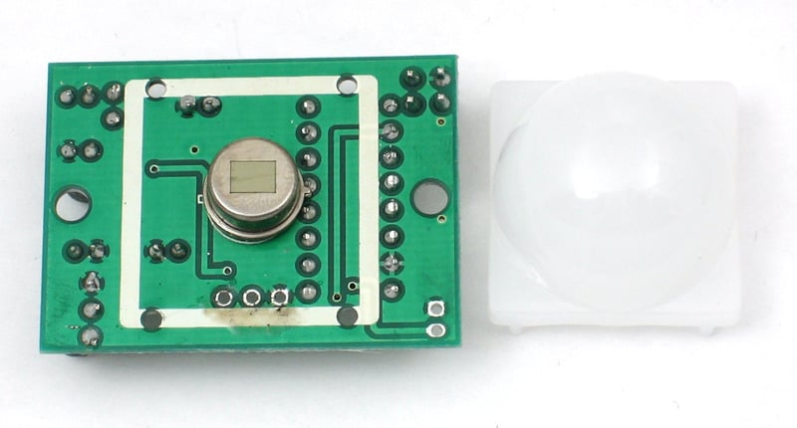
PIRs are basically made of a pyroelectric sensor (which you can see below as the round metal can with a rectangular crystal in the center), which can detect levels of infrared radiation.
Everything emits some low level radiation, and the hotter something is, the more radiation is emitted.
The sensor in a motion detector is actually split in two halves.
The reason for that is that we are looking to detect motion (change) not average IR levels.
The two halves are wired up so that they cancel each other out. If one half sees more or less IR radiation than the other, the output will swing high or low.

Slide 5
How PIRs Work?
-PIR sensors are more complicated than many of the other sensors (like photocells, FSRs and tilt switches)
because there are multiple variables that affect the sensors input and output.
-The PIR sensor itself has two slots in it, each slot is made of a special material that is sensitive to IR.
-When the sensor is idle, both slots detect the same amount of IR, the ambient amount radiated from the room or walls or outdoors.
-When a warm body like a human or animal passes by, it first intercepts one half of the PIR sensor, which causes a positive differential change between the two halves.
-When the warm body leaves the sensing area, the reverse happens, whereby the sensor generates a negative differential change.
-These change pulses are what is detected.

Slide 6
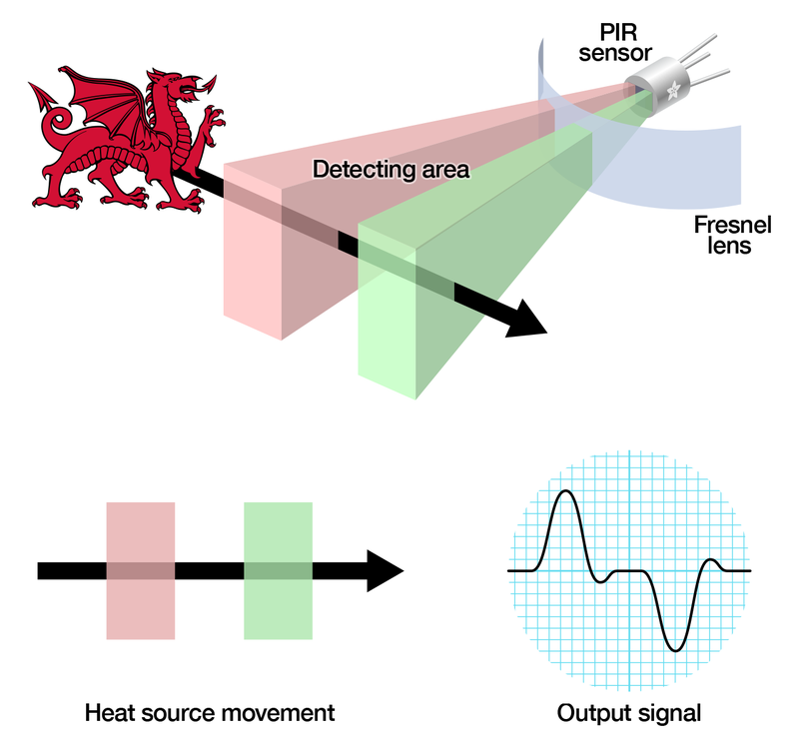

Slide 7
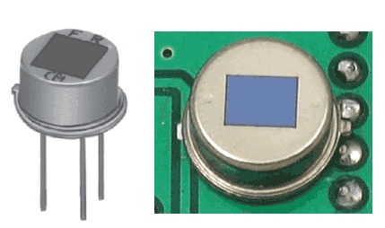
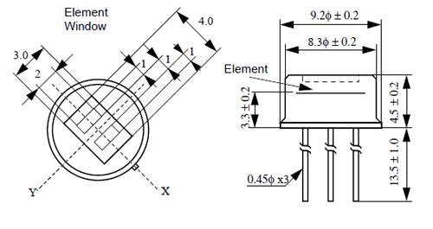
The PIR Sensor
The IR sensor itself is housed in a hermetically sealed metal can to improve noise/temperature/humidity immunity.
There is a window made of IR-transmissive material (typically coated silicon since that is very easy to come by) that protects the sensing element.
Behind the window are the two balanced sensors.

Slide 8
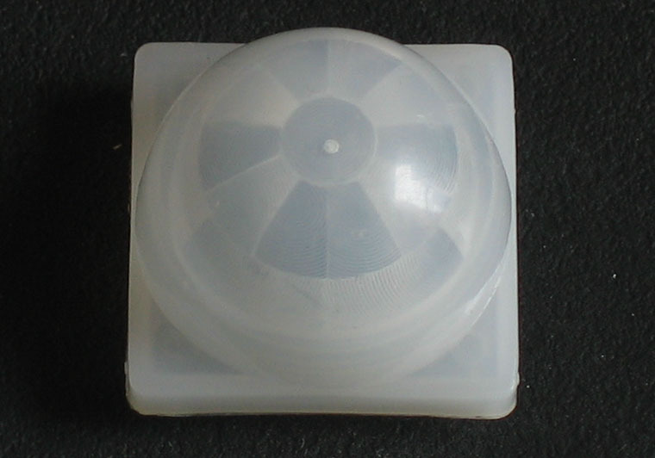
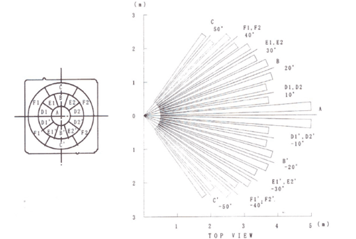
Lenses
PIR sensors are rather generic and for the most part vary only in price and sensitivity.
Most of the real magic happens with the optics.
This is a pretty good idea for manufacturing: the PIR sensor and circuitry is fixed and costs a few dollars.
The lens costs only a few cents and can change the breadth, range, sensing pattern, very easily.
In the diagram up top, the lens is just a piece of plastic, but that means that the detection area is just two rectangles.
Usually we'd like to have a detection area that is much larger.
To do that, we use a simple lens such as those found in a camera: they condenses a large area (such as a landscape) into a small one (on film or a CCD sensor).
For reasons that will be apparent soon, we would like to make the PIR lenses small and thin and moldable from cheap plastic, even though it may add distortion.

Slide 9
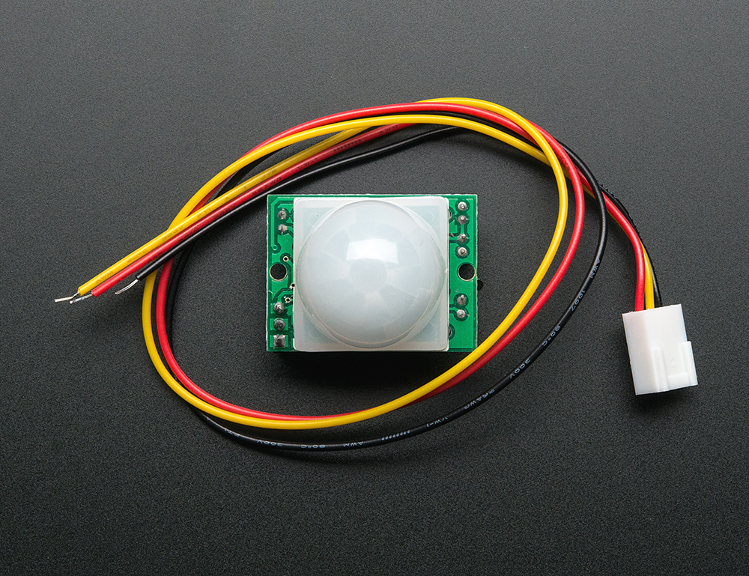
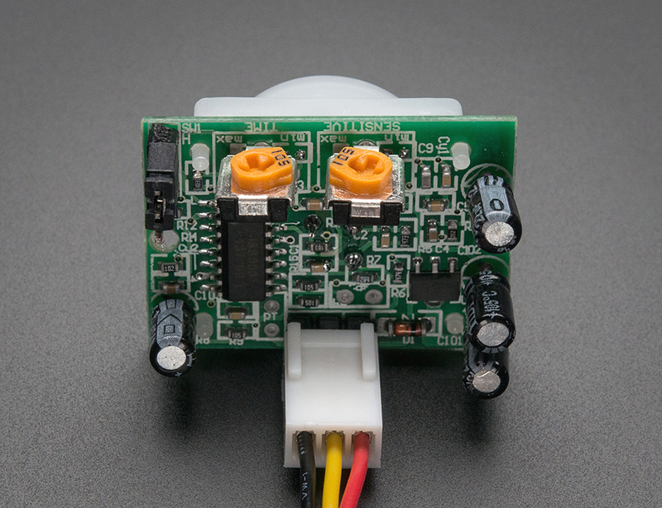
Connecting to a PIR
Most PIR modules have a 3-pin connection at the side or bottom.
The pinout may vary between modules so triple-check the pinout! It's often silkscreened on right next to the connection (at least, ours is!) One pin will be ground, another will be signal and the final one will be power.
Power is usually 3-5VDC input but may be as high as 12V.
Sometimes larger modules don't have direct output and instead just operate a relay in which case there is ground, power and the two switch connections.

Slide 10
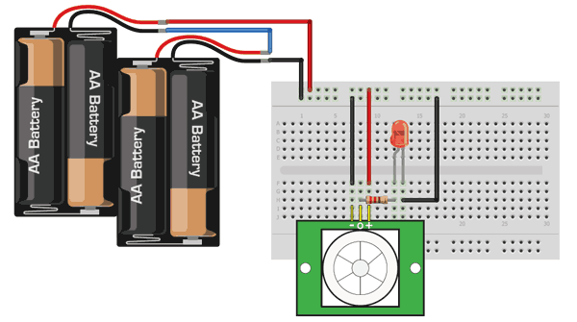
Testing a PIR
Now when the PIR detects motion, the output pin will go "high" to 3.3V and light up the LED!
Once you have the breadboard wired up, insert batteries and wait 30-60 seconds for the PIR to 'stabilize’.
During that time the LED may blink a little.
Wait until the LED is off and then move around in front of it, waving a hand, etc, to see the LED light up!
Retriggering(إعادة الإثارة) + Changing sensitivity
Testing a PIR | PIR Motion Sensor | Adafruit Learning System
Take a look in website

Slide 11
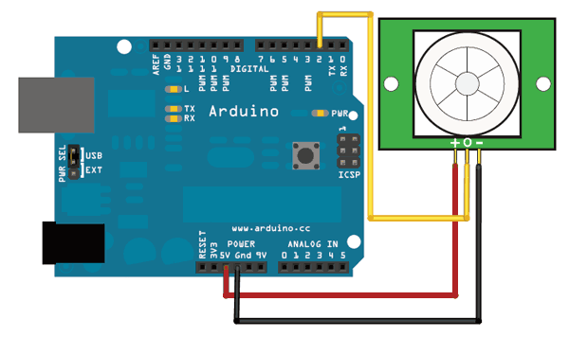
Using a PIR w/Arduino
Reading PIR Sensors:
The PIR acts as a digital output, it can be high voltage or low voltage, so all you need to do is listen for the pin to flip high (detected) or low (not detected) by listening on a digital input on your Arduino.
Its likely that you'll want retriggering, so be sure to put the jumper in the H position!
Power the PIR with 5V and connect ground to ground.
Then connect the output to a digital pin. In this example we'll use pin 2.

Slide 12
/*
* PIR sensor tester
*/
int ledPin = 13; // choose the pin for the LED
int inputPin = 2; // choose the input pin (for PIR sensor)
int pirState = LOW; // we start, assuming no motion detected
int val = 0; // variable for reading the pin status
void setup() {
pinMode(ledPin, OUTPUT); // declare LED as output
pinMode(inputPin, INPUT); // declare sensor as input
Serial.begin(9600);
}
Code

Slide 13
void loop(){
val = digitalRead(inputPin); // read input value
if (val == HIGH) { // check if the input is HIGH
digitalWrite(ledPin, HIGH); // turn LED ON
if (pirState == LOW) {
// we have just turned on
Serial.println("Motion detected!");
// We only want to print on the output change, not state
pirState = HIGH;
}
} else {
digitalWrite(ledPin, LOW); // turn LED OFF
if (pirState == HIGH){
// we have just turned of
Serial.println("Motion ended!");
// We only want to print on the output change, not state
pirState = LOW;
}
}
}
Cont.

Slide 14
Reference:
Overview | PIR Motion Sensor | Adafruit Learning System

Slide 15
THANKs
Amr Rabea

